Slide 1
Central Limit Theorem
Betting on the Law of Averages in a Casino

Slide 2
Table of contents
01
02
03
04
Setting the Scene
Dice Game & Basic Experiment
The Essence of CLT & Slot Machine Analogy
Implications & Conclusions

Slide 3
01
Welcome to the Casino!

Slide 4


Slide 5
Why Does This Matter in a Casino?
Casinos operate on probabilities. The house knows the averages and relies on the law of large numbers.
For players: Understanding the CLT can inform strategy. Realizing single plays are random but averages over many plays are predictable can guide betting decisions.

Slide 6
02
Dice Game

Slide 7

The casino is a place of chance and probabilities!!!

Slide 8
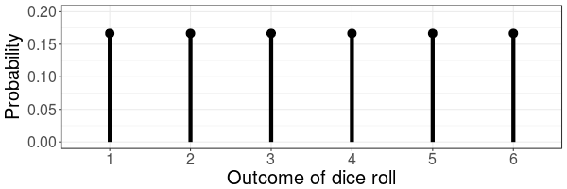
The Game of Dice
Probability distribution:
Each number (1-6) has an equal chance of 1/6.
Roll a die and observe the result.

Slide 9
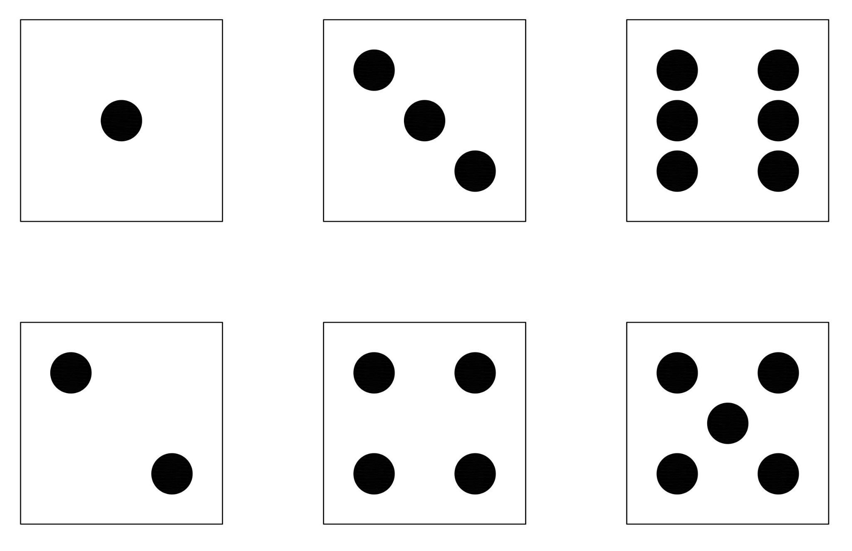
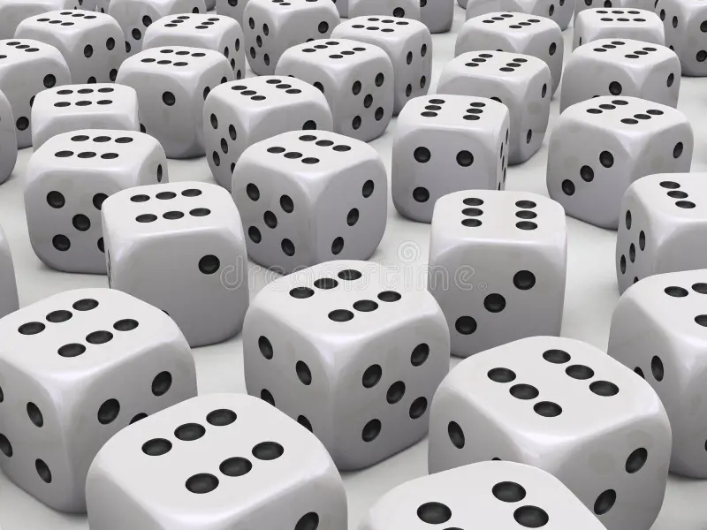
A Single Roll vs. Multiple Rolls
Single Roll: Completely random, any of the 6 results is as likely as the others.
Rolling the die, say, 30 times: The average of these rolls isn’t as unpredictable as the single rolls.

Slide 10
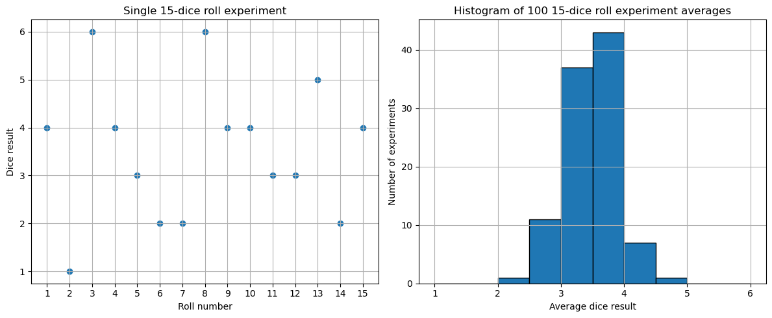
Rolling Experiment

Slide 11
03
The Essence of CLT & Slot Machine Analogy

Slide 12
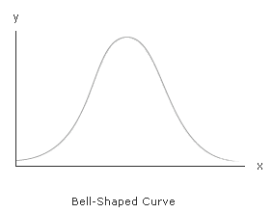
The Magic of Large Numbers
With more repetitions of the 15-roll experiment, the distribution of averages becomes bell-shaped.

Slide 13
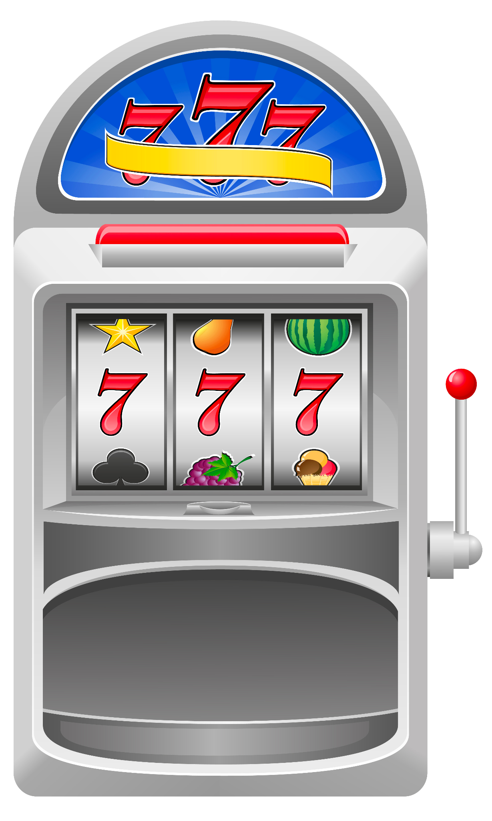
Back to the Casino -
Slot Machines
The outcomes aren't equally likely unlike our fair dice.

Slide 14
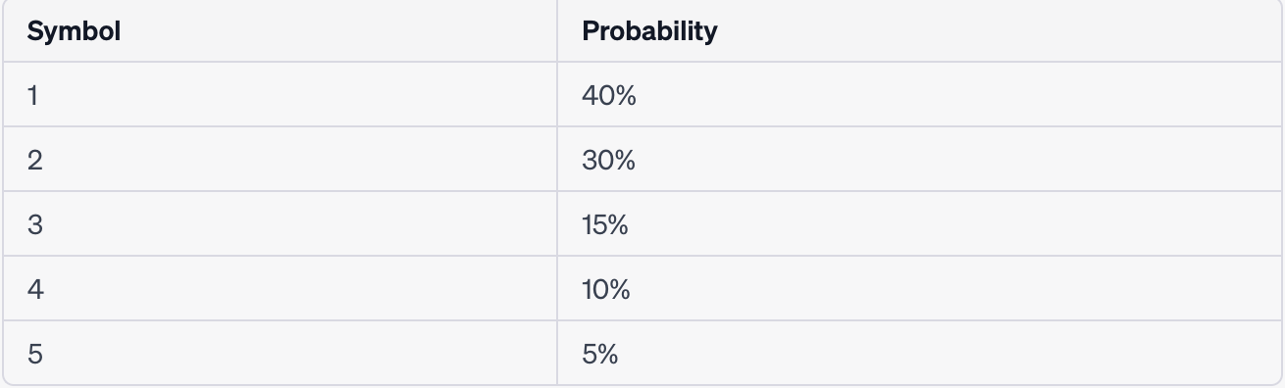
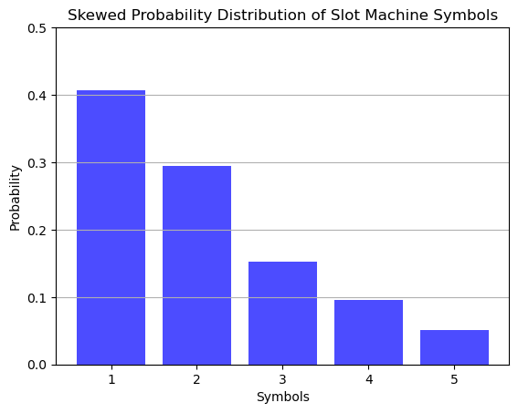
Weird probability distribution

Slide 15
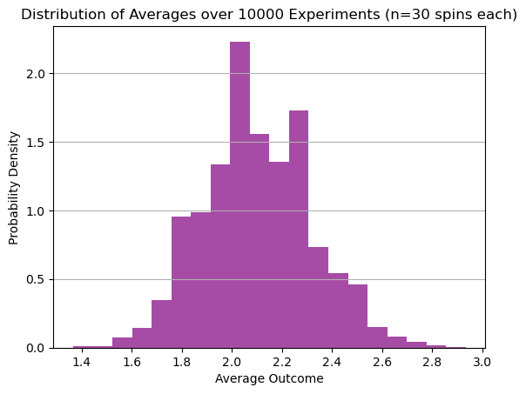
CLT in Action Again!

Slide 16
04
Implications & Conclusions

Slide 17
Real-World Applications Beyond the Casino
Quality Control and Manufacturing:
Companies regularly take samples of their products to test for quality. If they take sufficiently large samples, the mean quality measurement will be approximately normally distributed, regardless of the distribution of quality in the entire batch.
Medicine:
In drug testing, researchers might be interested in the average effect of a drug in a population. By taking sufficiently large samples, researchers can assume the sample mean effect is normally distributed, even if the population distribution is unknown or skewed
Education:
Educators and policymakers can use the CLT to analyze test scores, assess teaching methods, or gauge overall school performance. By taking large samples, they can make generalizations about the entire student population's performance.

Slide 18
Concluding Thoughts
The Central Limit Theorem is like a predictable friend in a world full of randomness.
In a casino or life, it’s always good to have some predictability!

Slide 19
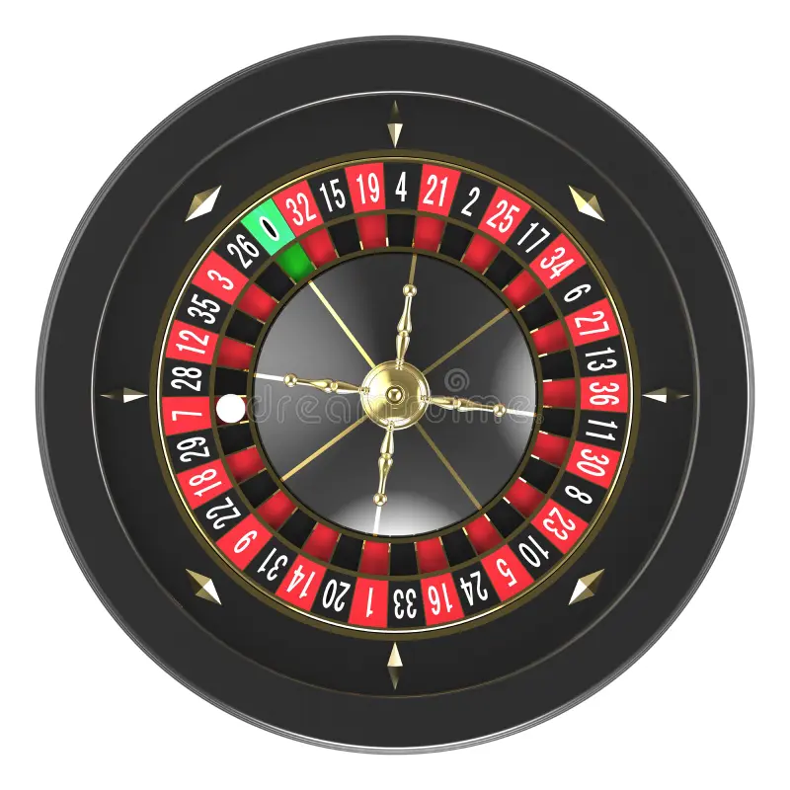
Our team
Arios
Aryan
Dawei
Obtin

Slide 20
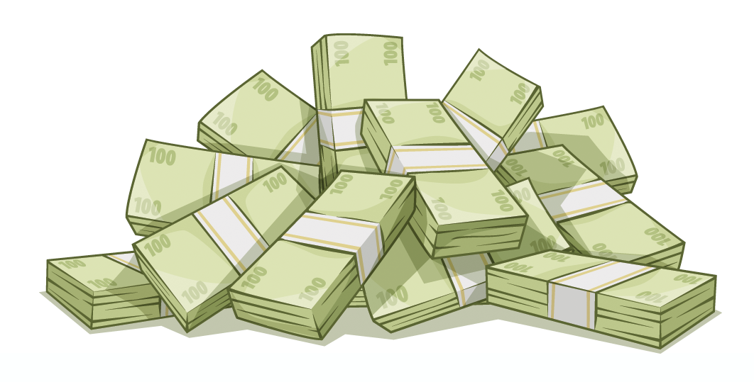
Thanks!
Do you have any questions?

